Slide 1


National Technical University of Ukraine “Igor Sikorsky Kyiv Polytechnic Institute”
Національний технічний університет України “Київський політехнічний інститут імені Ігоря Сікорського”
Network Software Development
(Програмне забезпечення мереж передачі даних)

Slide 2
SCHEDULE, REQUIREMENTS AND DEADLINES
18 Лекцій (тести перед атестаціями, проміжні тести) + макс. 35 балів
3 Лабораторні роботи
Терміни здачі:
ЛР 1 – до першої атестації (+макс. 15 балів) – 14.03-26.03
ЛР2 – до другої атестації (+макс. 15 балів) – 02.05-15.05
ЛР3 – до залікового тижня (+макс. 15 балів) – 21.05
! Лабораторні роботи приймаються тільки у визначені терміни
Залік (+макс. 20 балів)
Допуск до заліку – мін. 60 балів за поточним контролем

Slide 3
Lecture’s, Lab’s resources
Презентації лекцій, тести, звіти
https://jaguar.ccc.ipt.pt/moodle/
Лабораторні роботи
Amazon Web Services Academy
Поточні бали
Електронний кампус КПІ

Slide 4

COURSE OVERVIEW
Data Networks Overview
Network Software Development

Slide 5
Introduction to the Internet of Things
Internet of Things: Concept
Internet of Things: Case Study

Slide 6

Internet of Things: Concept

Slide 7
















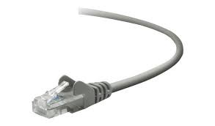
The Internet: a “nuts and bolts” view
Billions of connected computing devices:
hosts = end systems
running network apps at Internet’s “edge”
mobile network
national or global ISP
Packet switches: forward packets (chunks of data)
routers, switches
local or regional ISP
Internet
Communication links
fiber, copper, radio, satellite
transmission rate: bandwidth
home network
content
provider
network
datacenter
network
Networks
collection of devices, routers, links: managed by an organization
enterprise
network

Slide 8
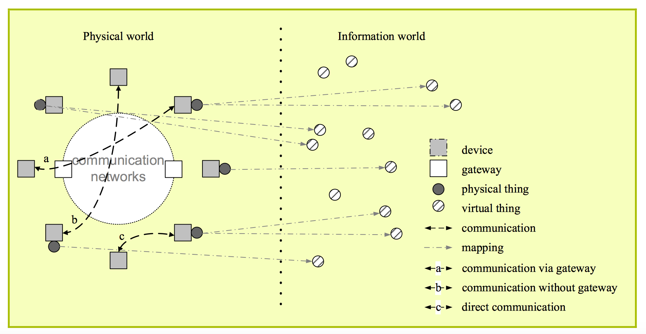
Internet of Things
Physical things
Exist in the physical world and are capable of being sensed, actuated and connected.
Examples: industrial robots, goods and electrical equipment.
Virtual things
Exist in the information world and are capable of being stored, processed and accessed.
Examples: Multimedia content, application software.
Source: Recommendation ITU-T Y.2060

Slide 9
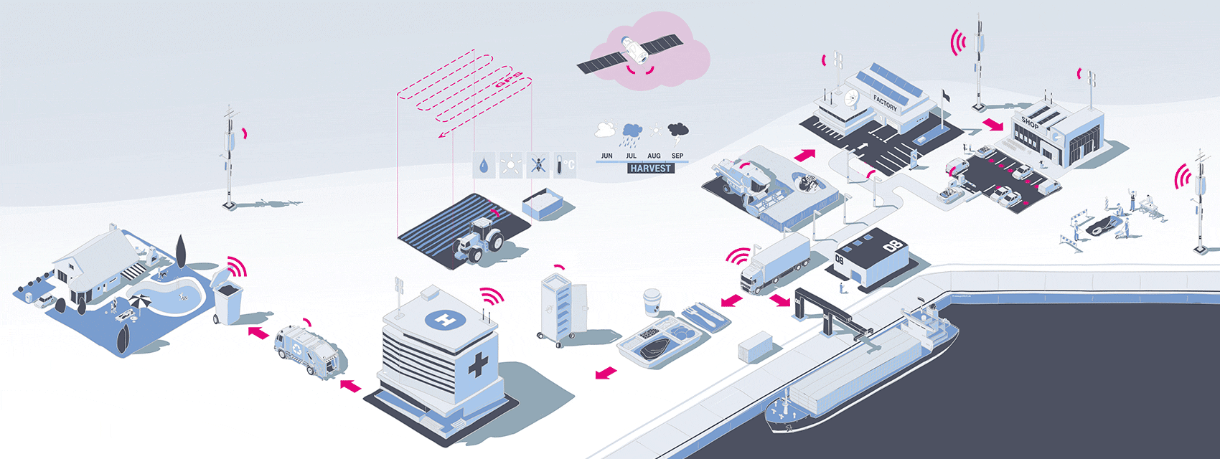
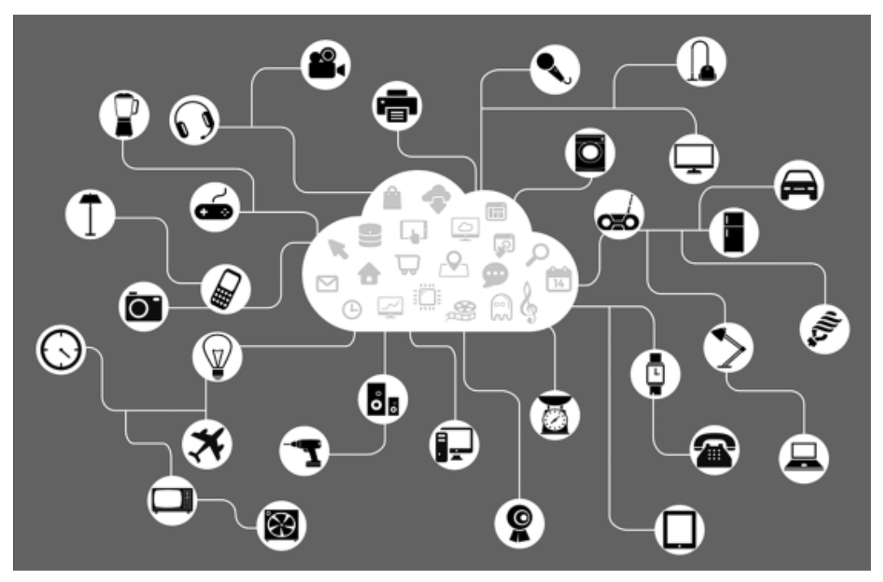
How does it look like?
9

Slide 10
What is IoT?
Internet of Things (IoT) comprises things that have unique identities and are connected to the Internet
The focus on IoT is in the configuration, control and networking via the Internet of devices or “Things” that are traditionally not associated with the internet
Eg: pump, utility meter, car engine
IoT is a new revolution in the capabilities of the endpoints that are connected to the internet
10

Slide 11
IoT (Some Industry Definitions)
A network connecting (either wired or wireless) devices, or ‘things’, that is characterized by autonomous provisioning, management, and monitoring. The IoT is innately analytical and integrated (IDC)
IoT is the next evolution of the Internet, connecting the unconnected people, processes, data, and things in your business today (Cisco)
IoT devices as those capable of two-way data transmission (excluding passive sensors and RFID tags). It includes connections using multiple communication methods such as cellular, short range and others. (GSMA)
Sensors & actuators connected by networks to computing systems. These systems can monitor or manage the health and actions of connected objects and machines. Connected sensors can also monitor the natural world, people, and animal” (McKinsey)
11

Slide 12



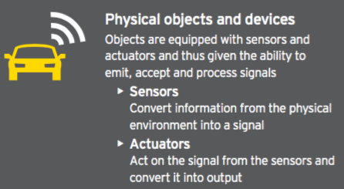

IoT Building Blocks
12

Slide 13
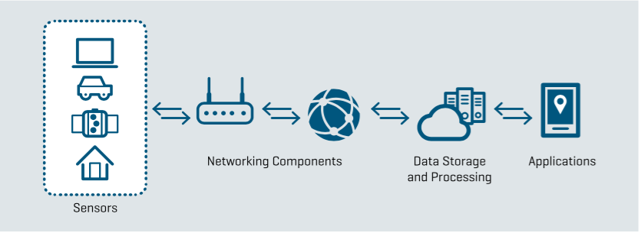
IoT Interaction
13

Slide 14
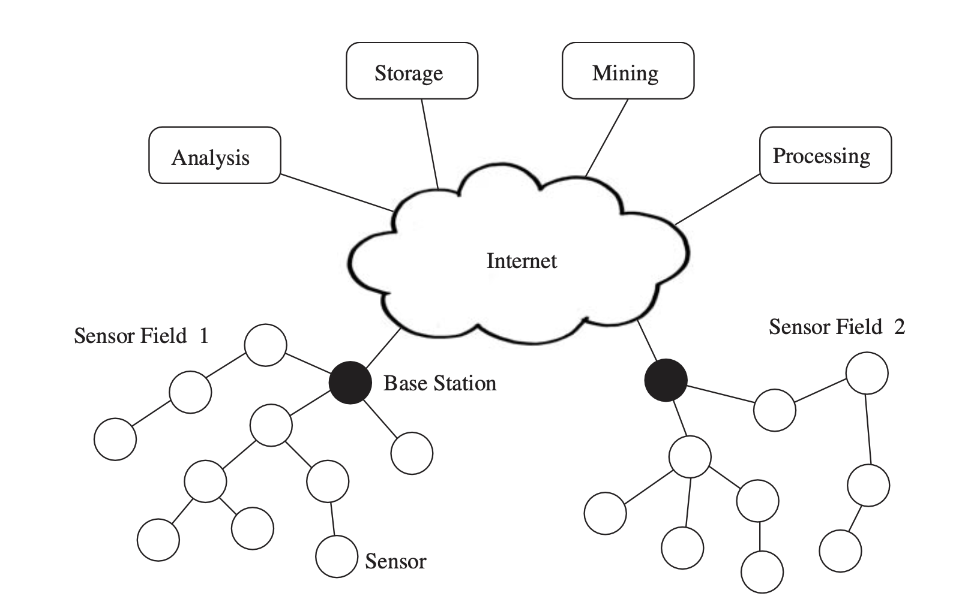
Wireless Sensor Network
14

Slide 15
Wireless Sensor Networks
Wireless Sensor Networks are networks that consists of sensors (nodes) and base stations which are distributed in an ad hoc manner.
These sensors work with each other to sense some physical phenomenon and then the information gathered is processed to get relevant results.
Wireless sensor networks consists of protocols and algorithms with self-organizing capabilities.
15

Slide 16
Wireless Sensor Networks
sensor
A transducer
converts physical phenomenon e.g. heat, light, motion, vibration, and sound into electrical signals
sensor node
basic unit in sensor network
contains on-board sensors, processor, memory, transceiver, and power supply
sensor network
consists of a large number of sensor nodes
nodes deployed either inside or very close to the sensed phenomenon
16

Slide 17




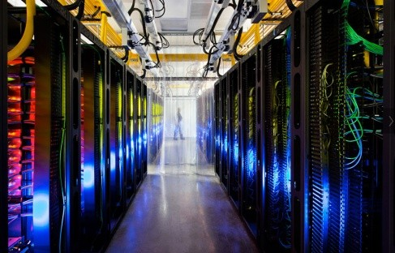
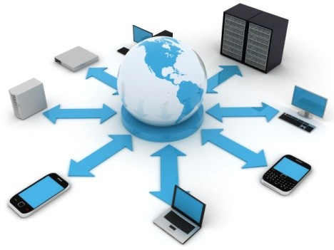
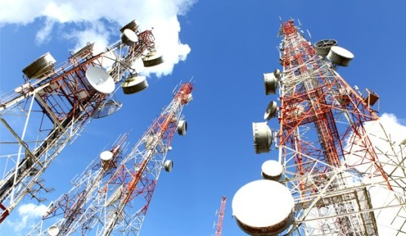
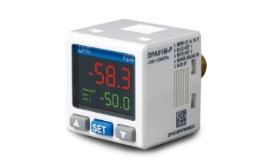
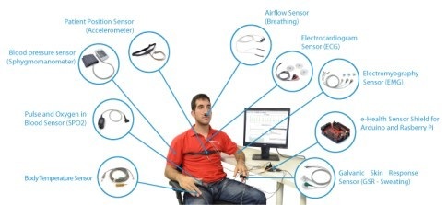
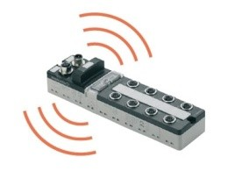
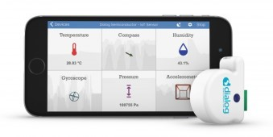
IoT: 4 layer Model
Integrated
Applications
Information
Processing
Network
Infrastructure
Sensing and
Identification

Slide 18
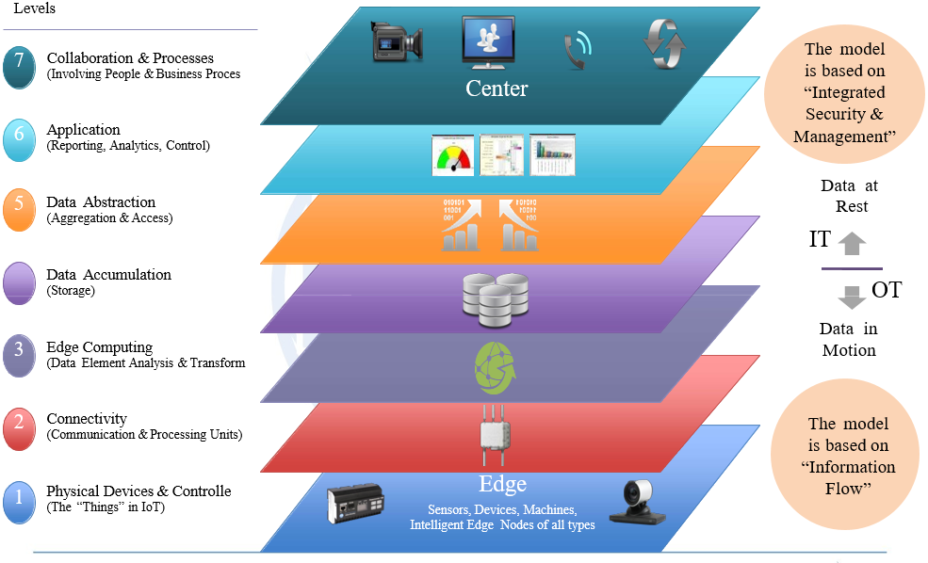
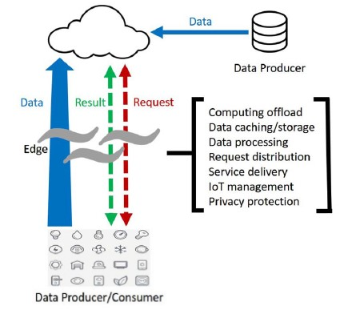
IoT: Reference Model
In IoT solutions supporting Fog Computing (FC) part of the application processing is executed directly at IoT objects and only when needed. More complex and resource-consuming tasks are transferred to higher level units (FC units) or directly to the cloud.
Notes:
Edge computing is interchangeable with fog computing.
Examples: a smart phone is the edge between body things and cloud, a gateway in a smart home is the edge between home things and cloud, a micro data center and a cloudlet is the edge between a mobile device and cloud

Slide 19
IoT design requirements
IoT Network | Impact on IoT Systems Design
Scale | Tens of thousand sensors in a given site; or millions distributed geographically More pressure on application architectures, network load, traffic types, security, non-standard usage pattern
Heterogeneous end-points | Vast array of sensors, actuators, and smart devices – IP or non-IP Diverse data rate exchange, form factor, computing and communication capabilities, legacy protocols
Low Capex and Opex requirement | May be deployed before activation, maybe or cannot-be accessed once deployed Low numbers of gateways Link budget: e.g: UL: 155 dB (or better), DL: Link budget: 153 dB (or better) Devices deliver services with little or no human control, difficult to correct mistakes, device management is key
Criticality of services | Human life critical (Healthcare), Critical infrastructure (Smart Grid) Stringent latency (10ms for SG) and reliability requirements, may challenge/exceed network capabilities of today
Intrusiveness | Things with explicit intent to better manage end-users (eHealth, Smart Grid) Issues of Privacy become major obstacles
Geography | Movement across borders Issues of numbering for unique identification
Source: ITU CoE training on BB networks planning, Bangkok, Sep 2017
19

Slide 20
IoT network connectivity requirements
IoT Network | Impact on IoT Systems Design
Resource-constrained endpoints | Severely resource constrained (memory, compute) Cost motivation: compute/memory several orders of magnitude lower, limited remote SW update capability, light protocols, security
Low Power | Some end-point types may be mostly ‘sleeping’ and awakened when required Sensors cannot be easily connected to a power source Reduced interaction time between devices and applications (some regulations state duty cycle of no more than 1%) Idle mode most of the time (energy consumption of around 100 µW). Connected mode just for transmission (mA) < 100 MHz clock frequency Embedded memory of few Mb
Embedded | Smart civil infrastructure, building, devices inside human beings Sensors deployed in secure or hostile operating conditions, difficult to change without impacting system, Security
Longevity | Deployed for life typically, have to build-in device redundancy Very different lifetime expectancy, rate of equipment change in IoT business domains much lower than ICT Industry
High Sensitivity on reception | Gateways and end-devices with a high sensitivity around -150 dBm/-125 dBm with Bluetooth lower than -95 dBm in in cellular
Source: ITU CoE training on BB networks planning, Bangkok, Sep 2017
20

Slide 21
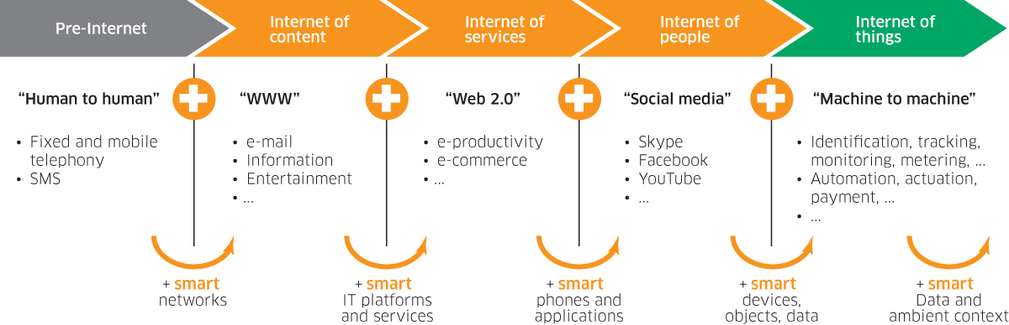
IoT Evolution
21

Slide 22
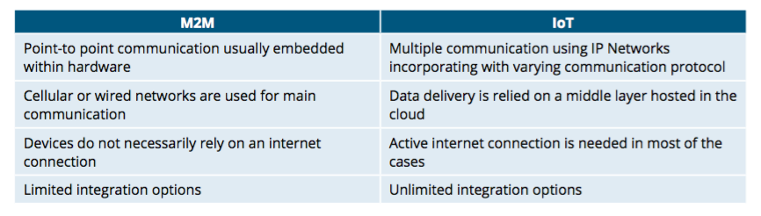
Machine-2-Machine vs Internet of Things
22

Slide 23
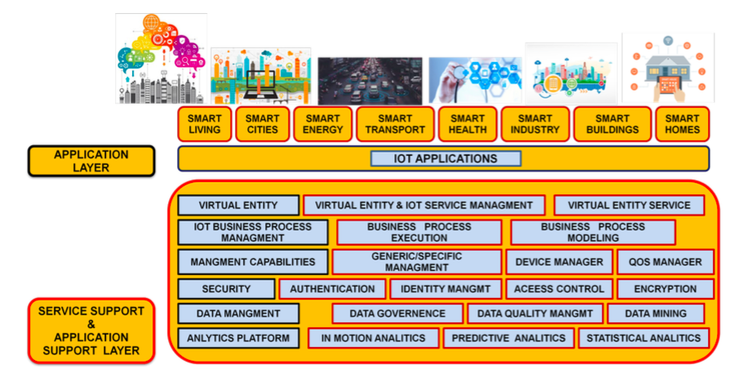
IoT Architecture - I
23

Slide 24
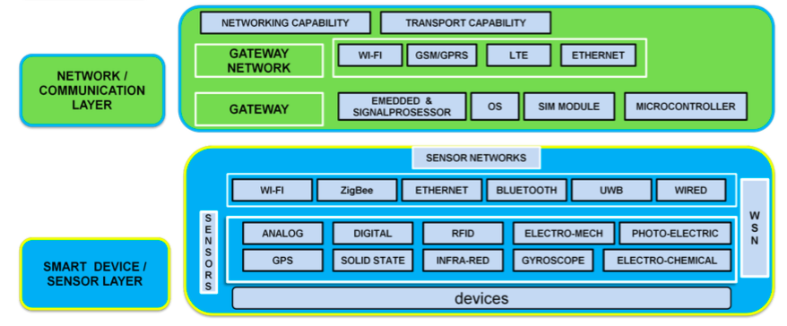
IoT Architecture -II
24

Slide 25
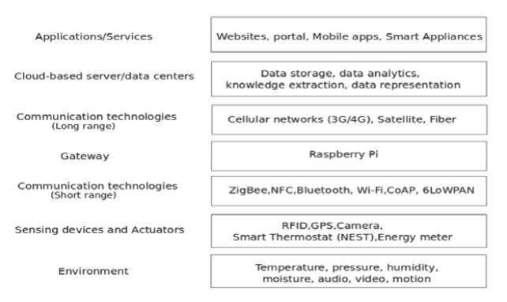
IoT Architecture
25

Slide 26
Internet of Things: Case Studies

Slide 27
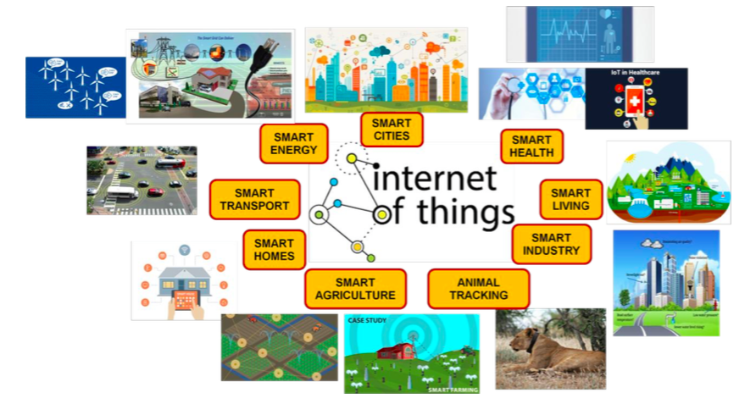
Application Areas
27

Slide 28
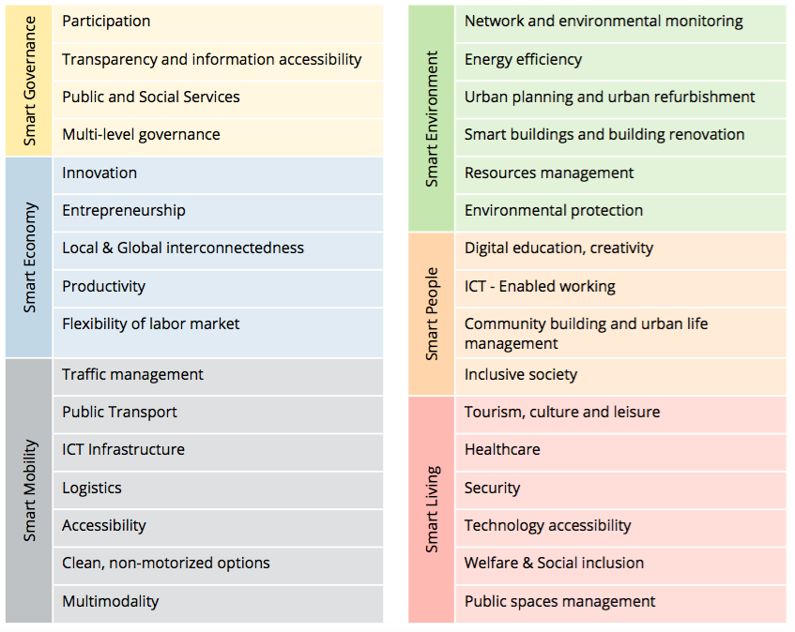
Factors and indicators of smart characteristics
28

Slide 29
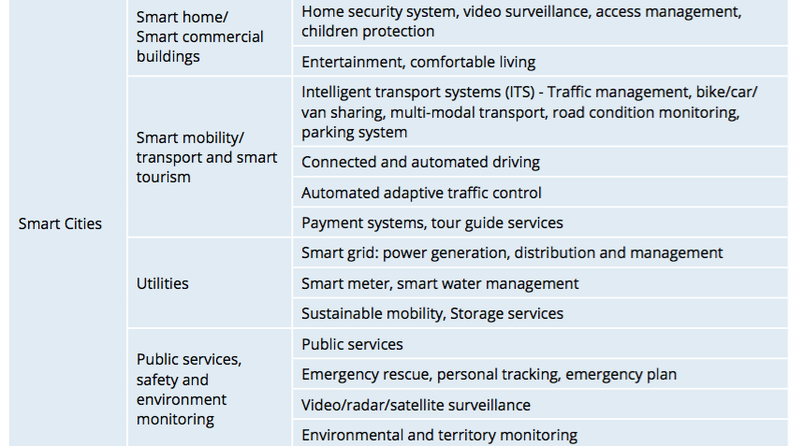
IoT Application Domains -I
29

Slide 30
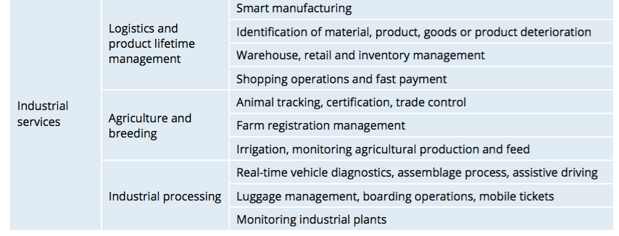
IoT Application Domains -II
30

Slide 31
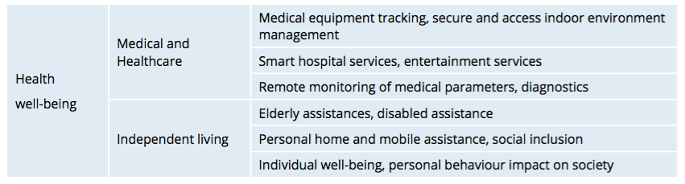
IoT Application Domains -III
31

Slide 32
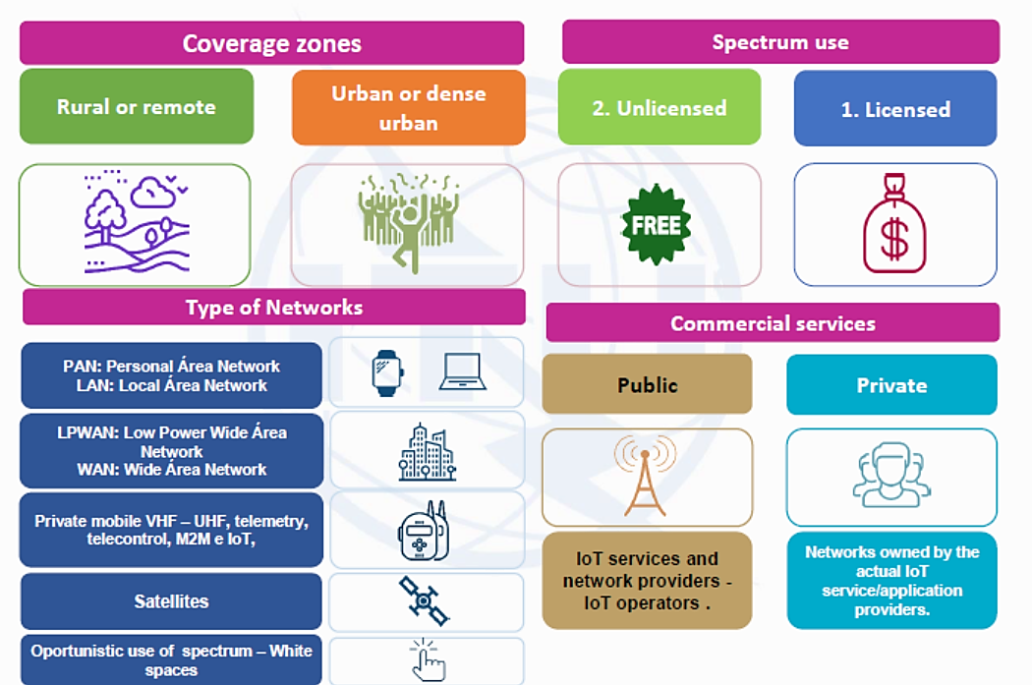
IoT Use Cases
32

Slide 33
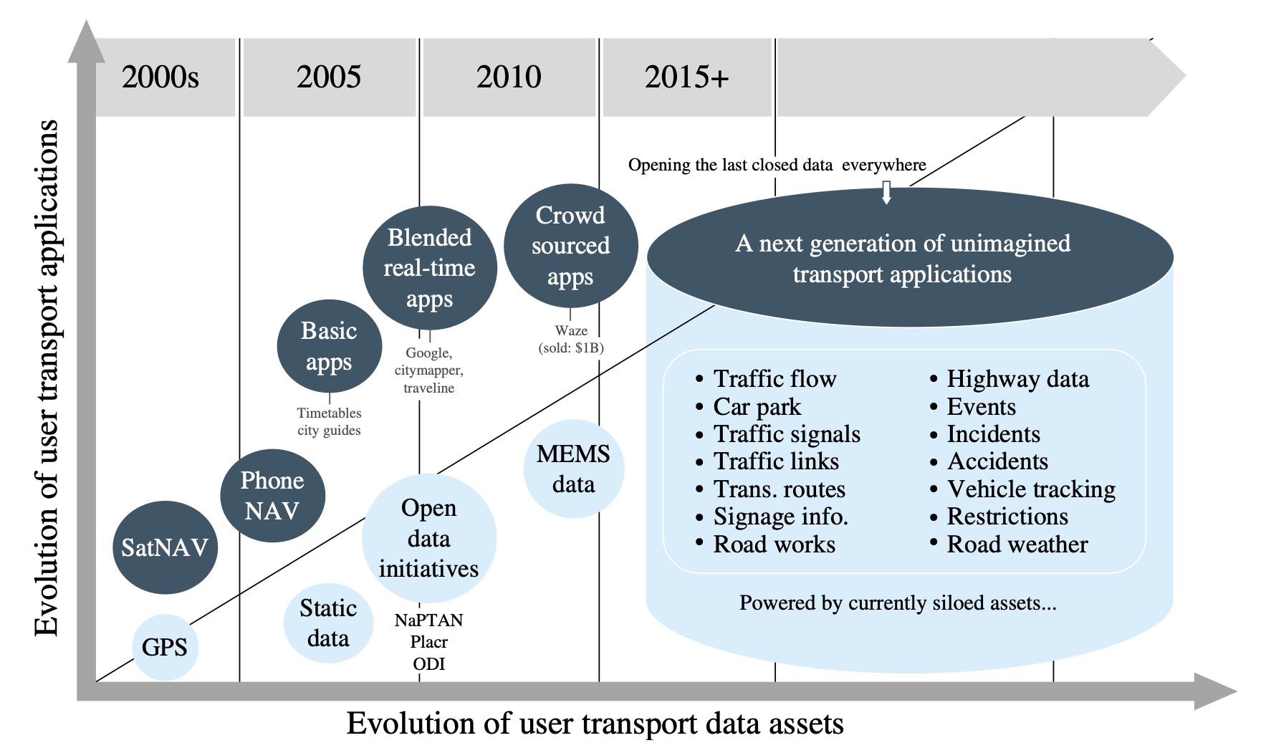
Intelligent Transportation
Evolution of transport applications and transport data assets
33

Slide 34
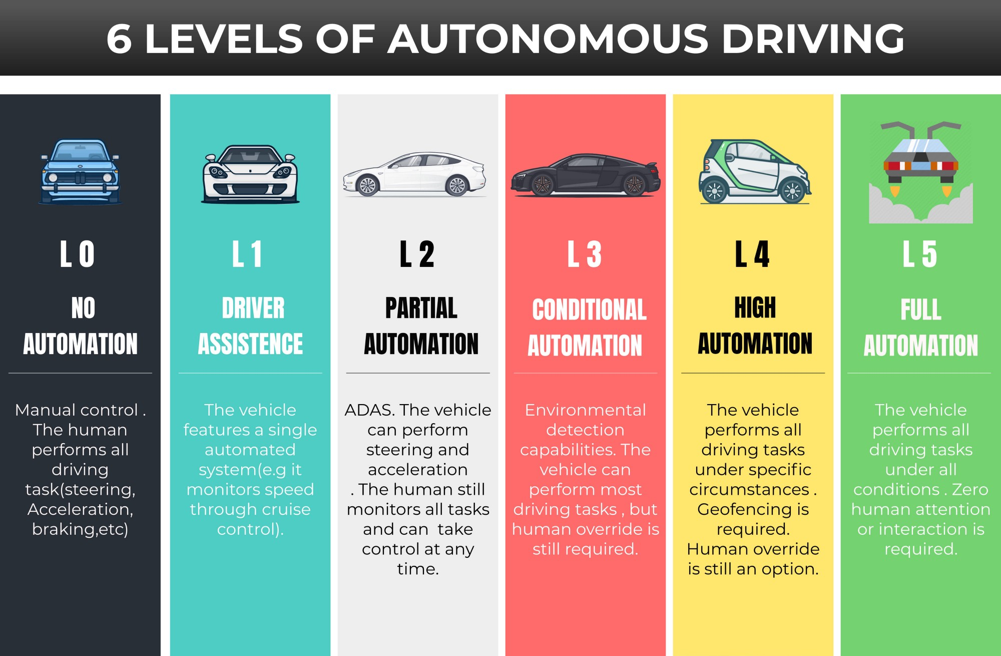
Connected and Autonomous Vehicles
34

Slide 35
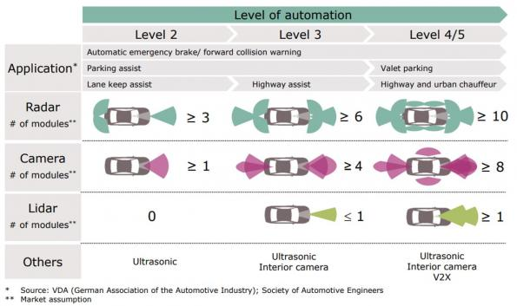
Means of Automation
35

Slide 36
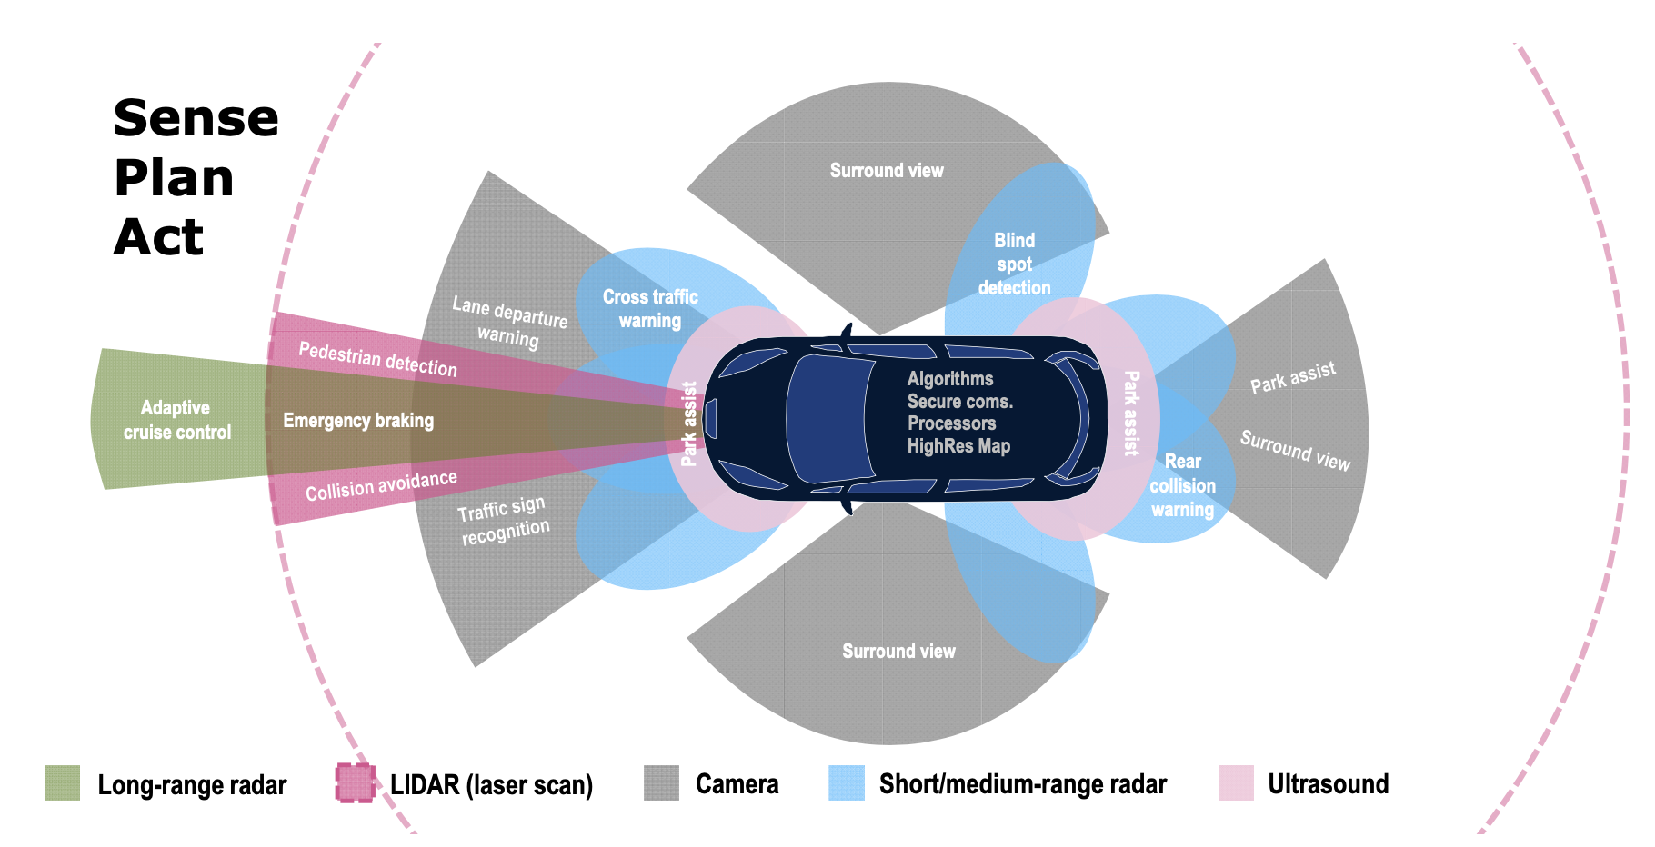
Sensors and Subsystems
36

Slide 37
Application Landscape - I
Information Services
Fault prediction and response
Data collection and generation
Data dissemination and distribution
Efficiency improvement
Convenience services
Group Motion Control
Platooning
Intersection control
Probe Vehicle Data
Vehicle Data Collection
Event Data Collection
Safety Services
Collision avoidance
Hazard reporting
Driver monitoring
Individual Motion Control
Signalized Intersections
Traffic Light Prioritisation
Signal Phase and Timing Information
Green Light Optimal Speed Advisory
Emergency Vehicle Priority
Public Transport Priority
37

Slide 38
Application Landscape - II
In-Vehicle Signage
Dynamic Speed Limit Information
Embedded VMS „Free Text“
Dynamic Lane Management
Shock Wave Damping
Other Signage Information
Hazardous Location Notification
Accident Zone
Traffic Jam Ahead
Weather Condition
Warning Temporarily slippery road
Animal or person on the road
Obstacle on the road
Emergency Vehicle Approaching/Intervention
Railway Level Crossing
Unsecured Blockage of a Road
Alert Wrong Way Driving
Public Transport Vehicle Crossing/At a Stop
Road Works Warning
Lane closure (and other restrictions)
Road closure
Road Works – Mobile
Winter Maintenance
Road Operator Vehicle in Intervention/Approaching
38

Slide 39
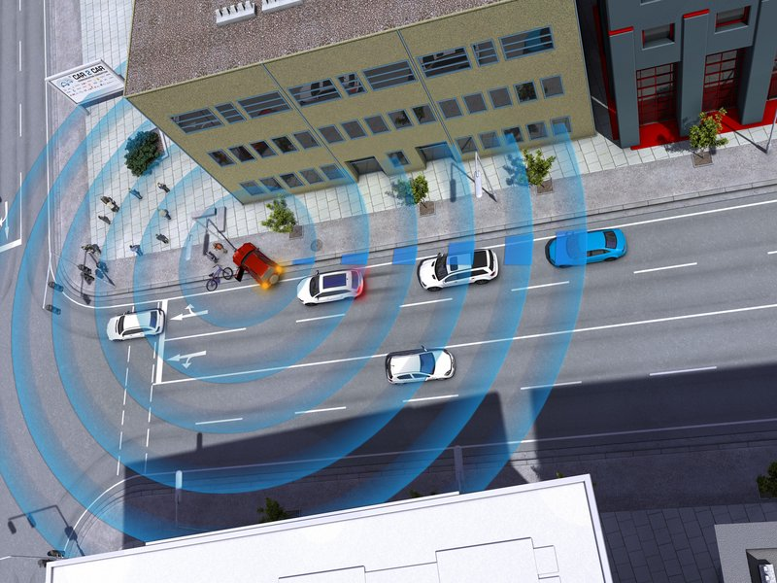
Awareness Driving
The exchange of status data via cooperative V2X communication, e. g. the position, speed, driving direction or special incidents like a vehicle defect, enables a set of information and warning services.
Examples are:
Intersection Collision Warning
Emergency Vehicle Warning
Dangerous Situation Warning
Stationary Vehicle Warning
Traffic Jam warning
Pre-/Postcrash Warning
*Source: https://car-2-car.org
39

Slide 40
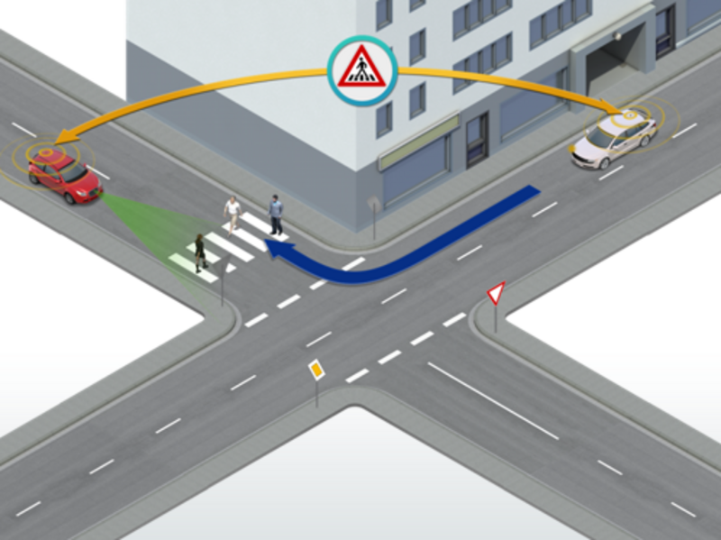
Sensing Driving
On top of status data, cooperative V2X capable road users can share observations gained by sensors, and advanced environmental information. This way, other traffic participants are not only warned against dangers they cannot perceive themselves yet; also, non-communicating road users are taken into account and protected in different traffic situations.
Examples are:
Overtaking Warning
Extended Intersection Collision Warning
Vulnerable Road User Warning
Cooperative Adaptive Cruise Control
Long-term Road Works Warning
Special Vehicle Prioritization
*Source: https://car-2-car.org
40

Slide 41
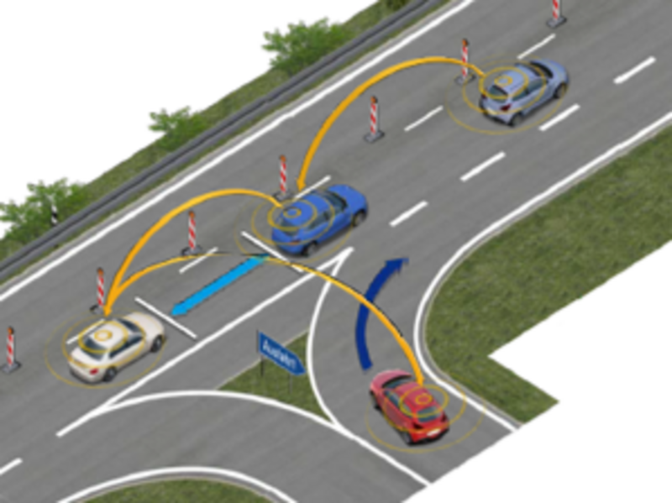
Cooperative Driving
In addition to status and sensor data, cooperative V2X road users can also provide intention data, allowing them to interact intelligently and to coordinate their behaviour even in complex traffic situations. The prediction of expected behaviour of all road users is an important requirement for the long-term goal of highly automated and autonomous driving.
Examples are:
(Static or dynamic) Platooning
Area reservation
Cooperative Merging
Cooperative Lane Change
Cooperative Overtaking
*Source: https://car-2-car.org
41

Slide 42
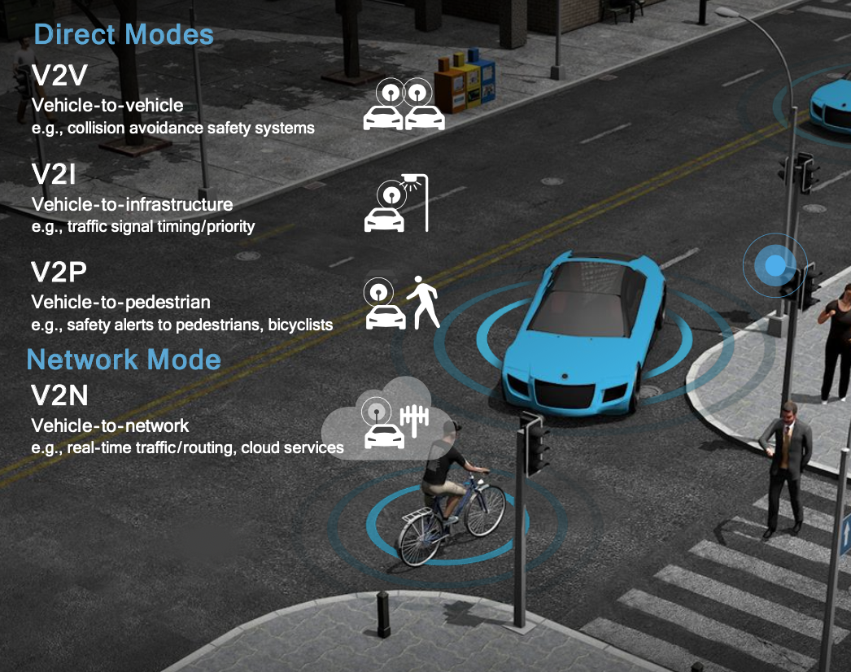
Connectivity - I
Vehicle-to-Vehicle (V2V)
Vehicle-to-Infrastructure (V2I)
Vehicle-to-Pedestrian (V2P)
Vehicle-to-Network (V2N)
Vehicle-to-Broadband (V2B)
Vehicle-to-Cloud (V2C)
Vehicle-to-Device (V2D)
…
Vehicle-to-Everything (V2X)
42

Slide 43
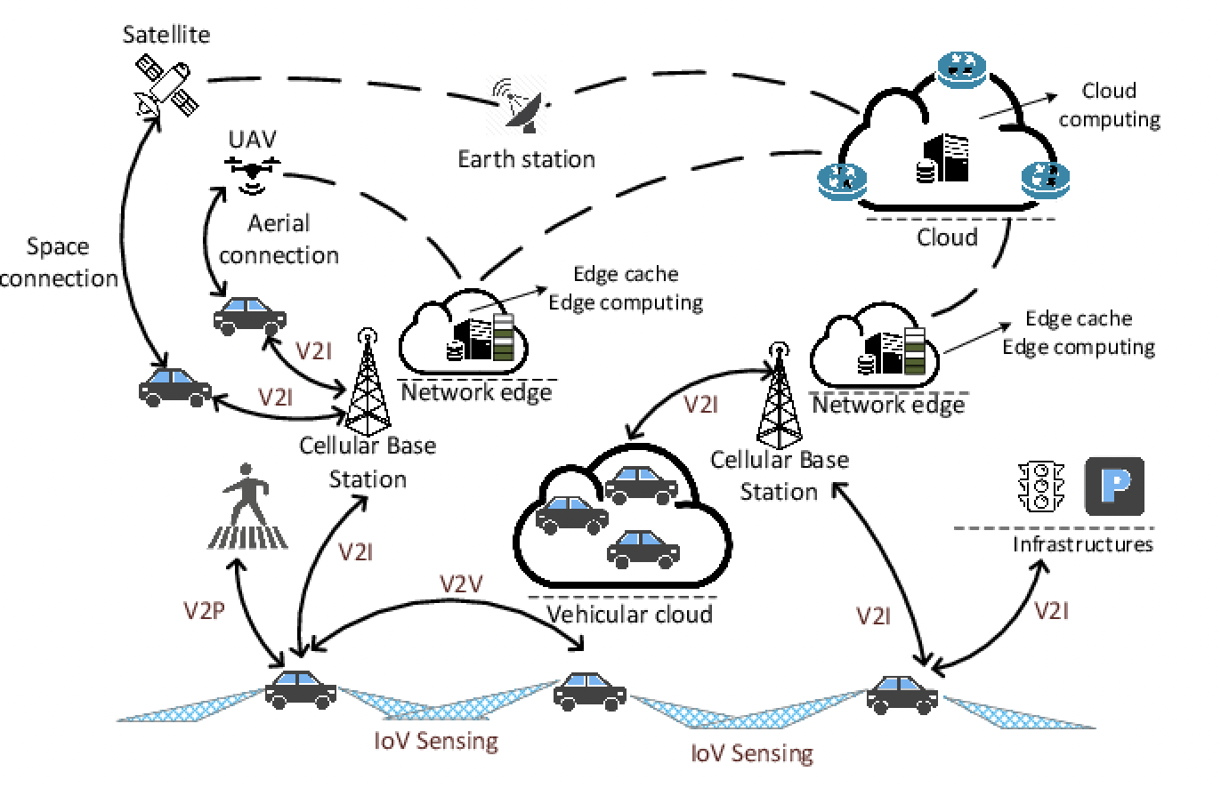
Connectivity
43

Slide 44
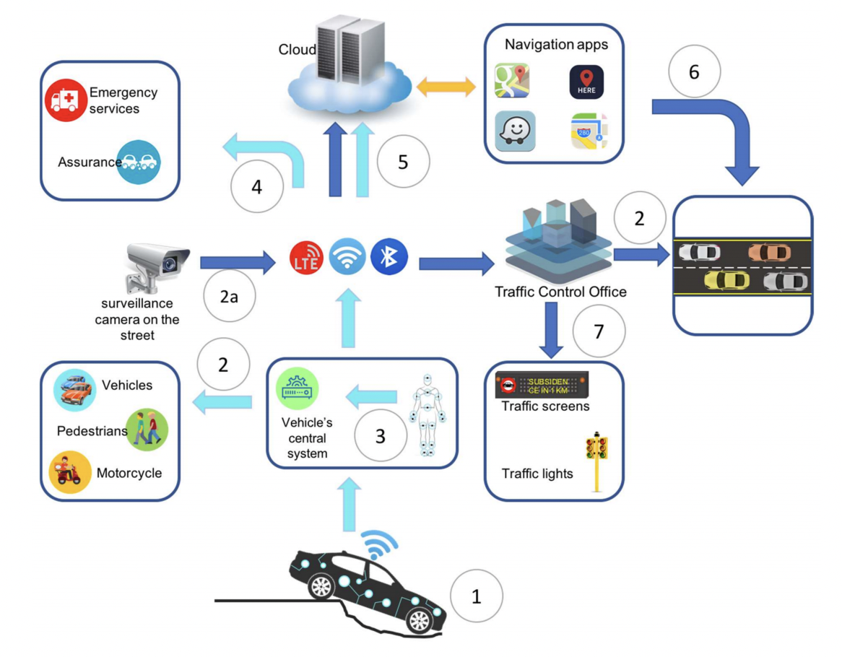
Case Study Scenario
44

Slide 45
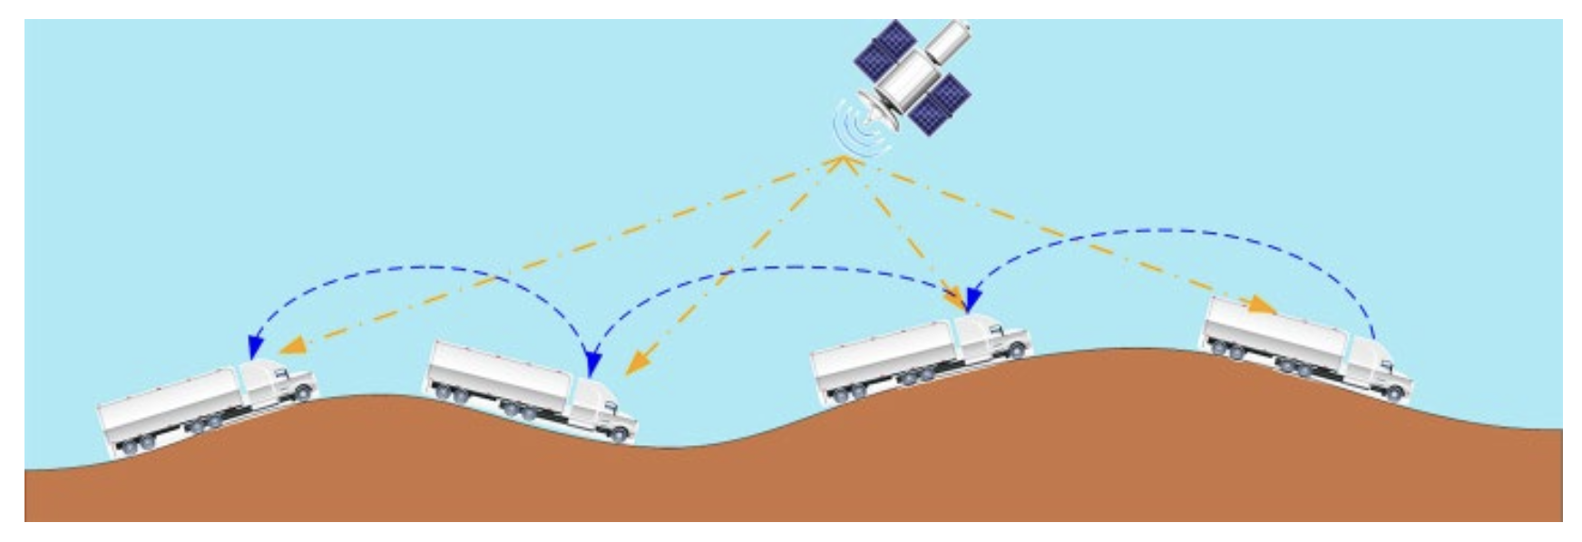
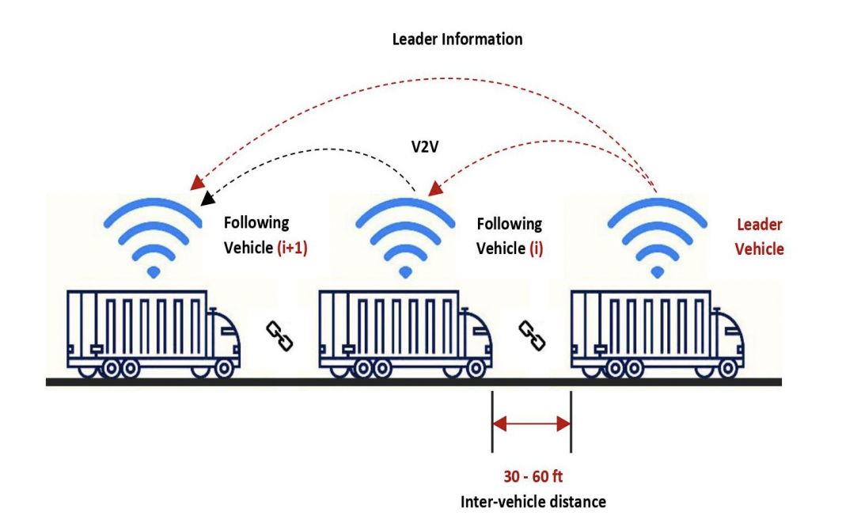
Track Convoys
45

Slide 46
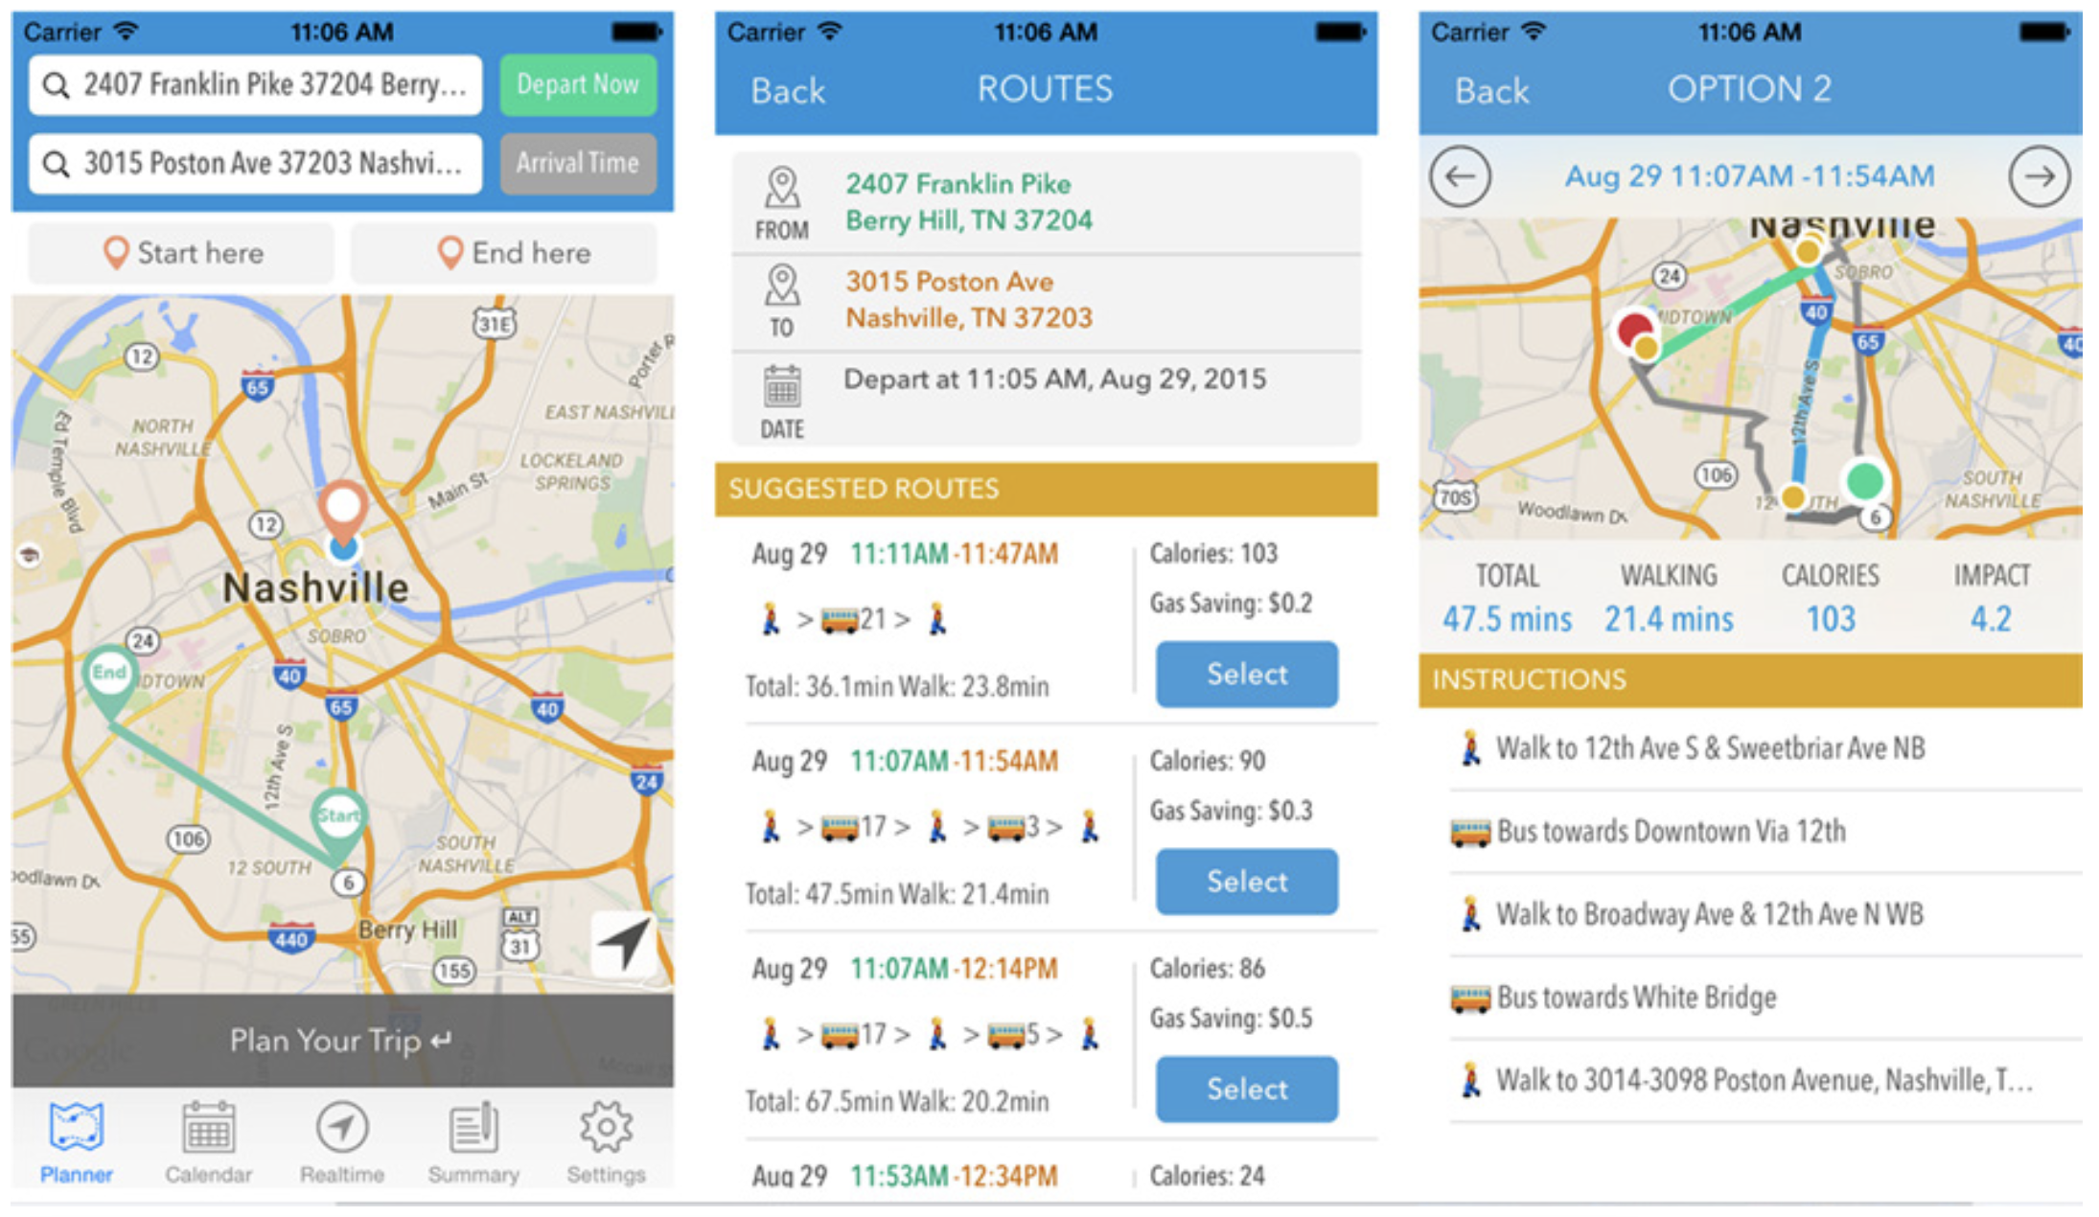
Intelligent Public Transport Operations
46

Slide 47
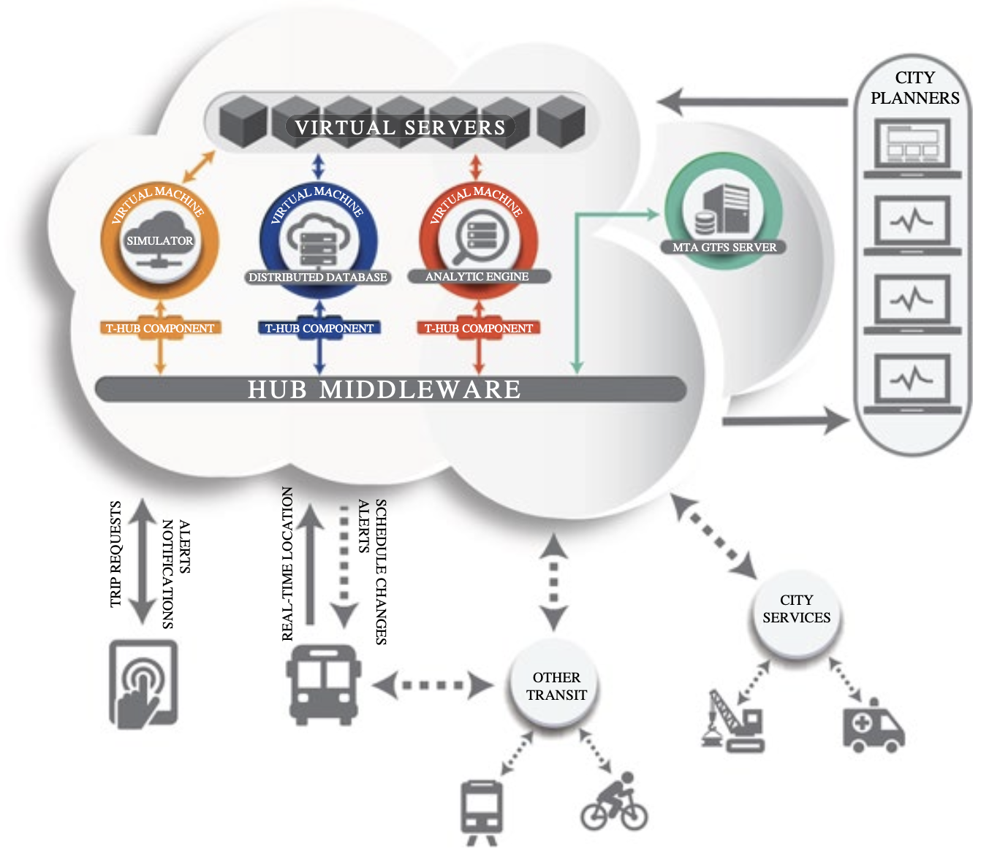
Intelligent Public Transport Operations
47

Slide 48
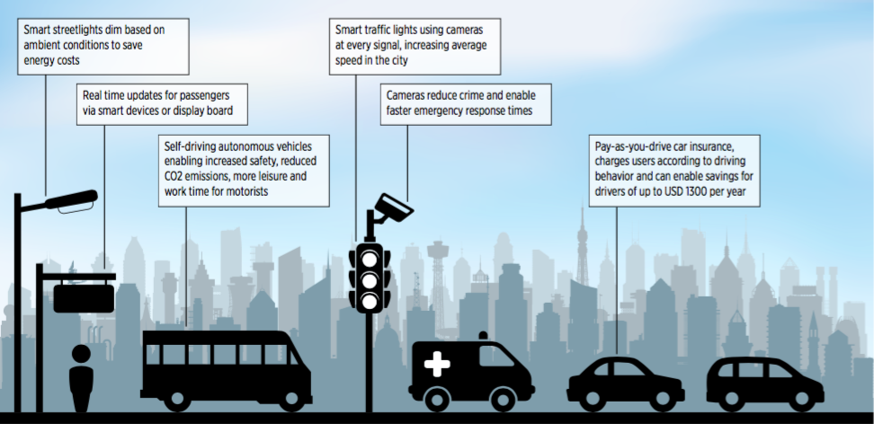
Smart Cities
48

Slide 49
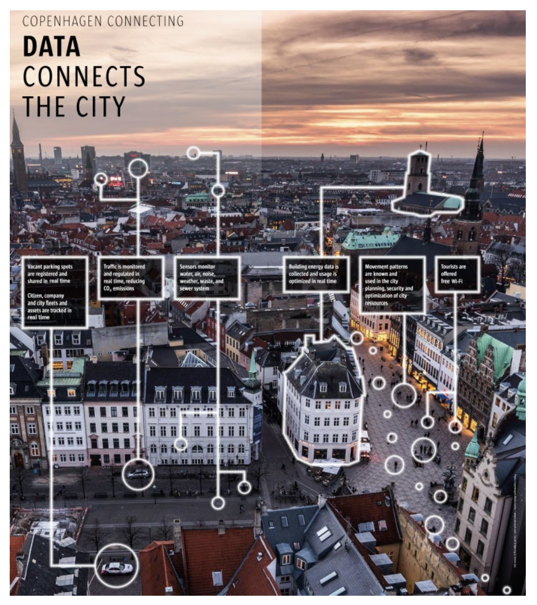
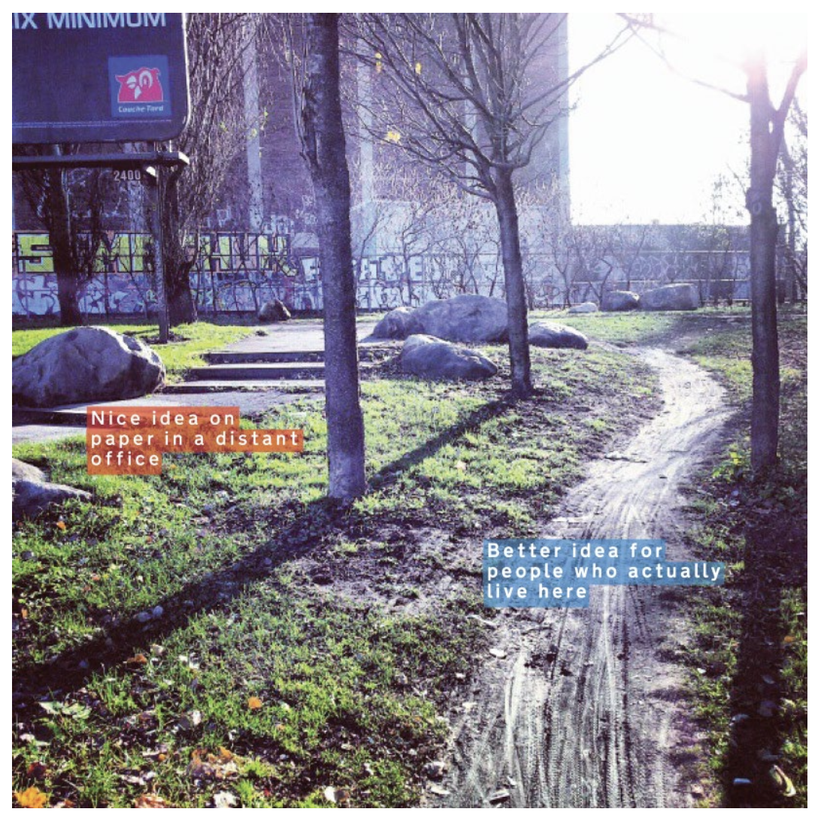
Smart Cities
49

Slide 50
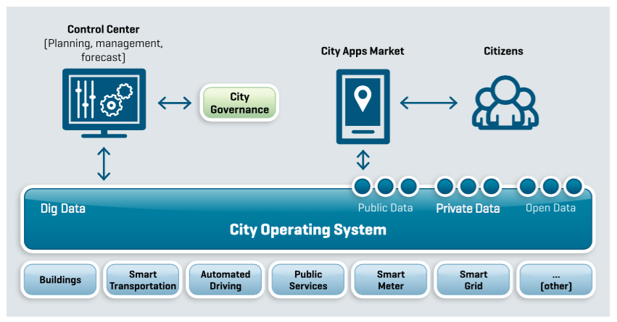
Implementation of the Smart Cities
50

Slide 51
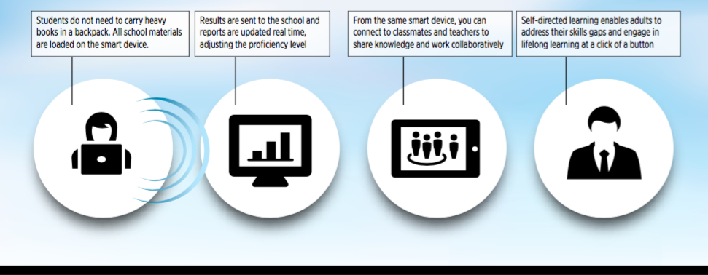
Education
51

Slide 52
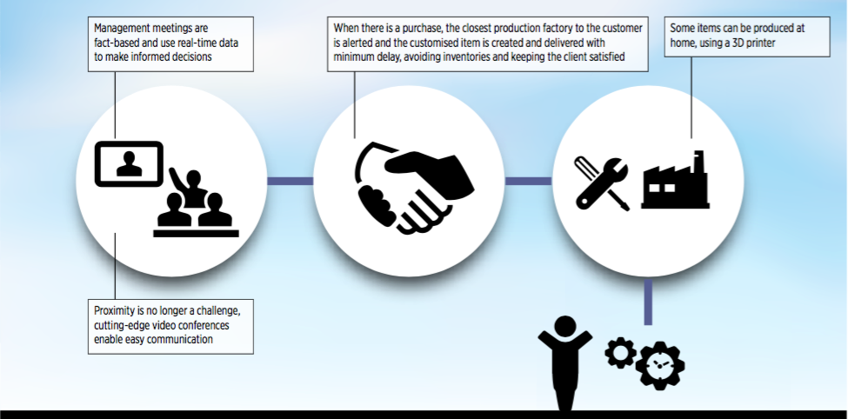
Productivity
52

Slide 53
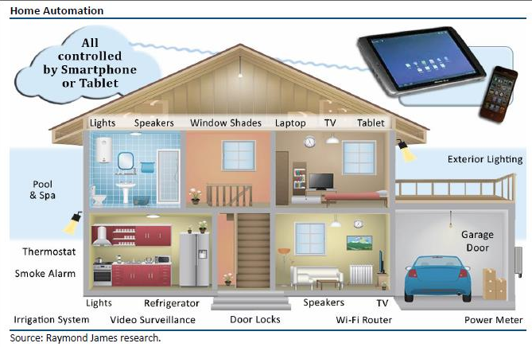
Smart Home
53

Slide 54
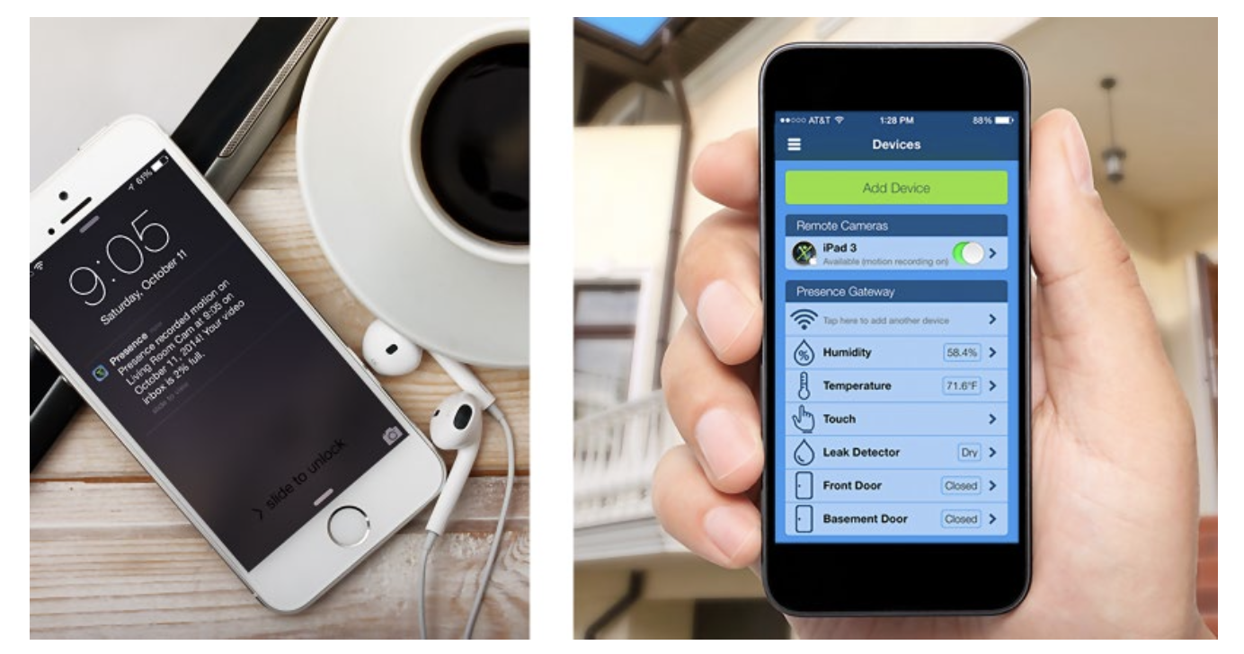
Smart Home
54

Slide 55
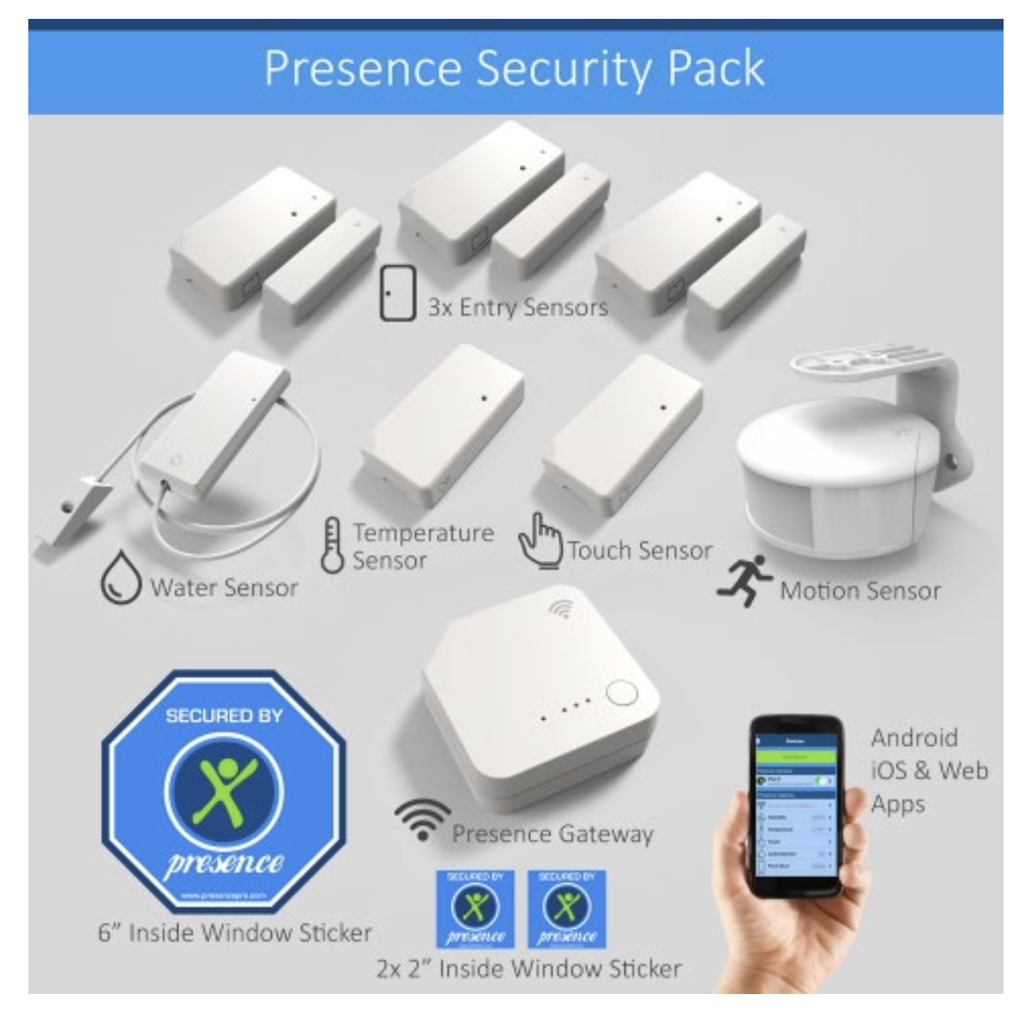
Smart Home
55

Slide 56


Structural Health Monitoring
56

Slide 57

Healthcare and Remote Patient Monitoring
57

Slide 58

Health Applications
58

Slide 59

Medical application
• Vital sign monitoring
• Accident recognition
• Monitoring the elderly
Intel deployed a 130-node network to monitor the activity of residents in an elder care facility.
Patient data is acquired with wearable sensing nodes (the “watch”)
59

Slide 60

Industry Sector Categories
60

Slide 61

IoTs and Industry 4.0
IoT & Standards-based protocols are helping IT and OT converge and drive new economic value streams
The Convergence of IT and OT
Information Technology (IT) supports connections to the internet along with related data and technology systems and is focused on the secure flow of data across and organization
Operational Technology (OT) monitors and controls devices and processes on physical operational systems (assembly lines, utility distribution networks, production facilities, roadway systems etc.
Typically, IT does not get involved with the production and logistics of OT environments
61

Slide 62

IoT Ecosystem
62

Slide 63

Applications of Wireless Sensor Networks
63

Slide 64
Environmental Applications
Forest fire detection
Bio-complexity mapping of environment
Flood detection
Precision Agriculture
Air and water pollution
64

Slide 65

Environment monitoring
Great Duck Island
150 sensing nodes deployed throughout the island relay data temperature, pressure, and humidity to a central device.
Data was made available on the Internet through a satellite link.
65

Slide 66

Environment monitoring
Zebranet: a WSN to study the behavior of zebras
Special GPS-equipped collars were attached to zebras
• Data exchanged with peer-to-peer info swaps
• Coming across a few zebras gives access to the data
66

Slide 67
Military Applications
Monitoring friendly forces, equipment, and ammunition
Battlefield surveillance
Reconnaissance of opposing forces and terrain
Targeting
Battle damage assessment
Nuclear, biological, and chemical attack detection
67

Slide 68

Underwater Acoustic Sensor Networks
68

Slide 69
Other Commercial Applications
Environmental control in office buildings
Interactive museums
Detecting and monitoring car thefts
Managing inventory control
Vehicle tracking and detection
69

Slide 70
Additional Info

Slide 71

IoT Components
71

Slide 72

IoT Definition
72

Slide 73

IoT Basic Characteristics -I
73

Slide 74

IoT Basic Characteristics -II
74

